Slide 1
ZooKeeper
  A highly available, scalable, distributed, configuration, consensus, group membership, leader election, naming, and coordination service

Slide 2
Observations
Observations
Observations
Distributed systems always need some form of coordination
Programmers cannot use locks correctly
Message based coordination can be hard to use in some applications
Wishes
Simple, Robust, Good Performance
Tuned for Read dominant workloads
Familiar models and interfaces
Wait-Free: A slow/failed client will not interfere with the requests of a fast client
Need to be able to wait efficiently

Slide 3
Design Starting Point
Start with the File API and model strip out what we don't need:
Partial writes/reads (takes with it open/close/seek)‏
Rename
add what we do need:
Ordered updates and strong persistence guarantees
Conditional updates
Watches for data changes
Ephemeral nodes
Generated file names

Slide 4
Data Model
Hierarchal namespace (like a file system)‏
Each znode has data and children
data is read and written in its entirety
/
services
YaView
servers
stupidname
morestupidity
locks
read-1
apps
users

Slide 5
ZooKeeper API
String create(path, data, acl, flags)‏
void delete(path, expectedVersion)‏
Stat setData(path, data, expectedVersion)‏
(data, Stat) getData(path, watch)‏
Stat exists(path, watch)‏
String[] getChildren(path, watch)‏
void sync(path)‏

Slide 6
Create Flags
Ephemeral: the znode will be deleted when the session that created it times out or it is explicitly deleted
Sequence: the the path name will have a monotonically increasing counter relative to the parent appended
/
Ephemerals
created by
Session X
services
YaView
servers
stupidname
morestupidity
locks
s-1
apps
Sequence
appended
on create
users

Slide 7
ZooKeeper Servers
ZooKeeper Service
Leader
Server
Server
Server
Server
Server
Server
Client
Client
Client
Client
Client
Client
Client
Client
All servers store a copy of the data (in memory)‏
A leader is elected at startup
Followers service clients, all updates go through leader
Update responses are sent when a majority of servers have persisted the change

Slide 8
HOD
A client submits a request to start jobtracker and a set of tasktrackers to torque
The ip address and the ports that the jobtracker will bind to is not known apriori
The tasktrackers need to find the jobtracker
The client needs to find the jobtracker
Torque
Client
JT
TT
TT
TT

Slide 9
HOD with ZooKeeper
Torque
Client
ZooKeeper
create /hod/jt- Ephemeral|Sequence
JT
TT
/
TT
/hod/jt-1
hod
TT

Slide 10
HOD with ZooKeeper
Torque
When the client spawns the TT and JT tasks
in torque, it passes the path of the newly
create znode (/hod/jt-1) as a startup parameter.
The client and TT watch the znode for data
populated by JT. JT and TT watch the existence
of the znode and exit if it goes away.
TT
JT
TT
TT
setData /hod/jt-1
<contact info>
Client
ZooKeeper
getData /hod/jt-1 true
/
hod
jt-1

Slide 11
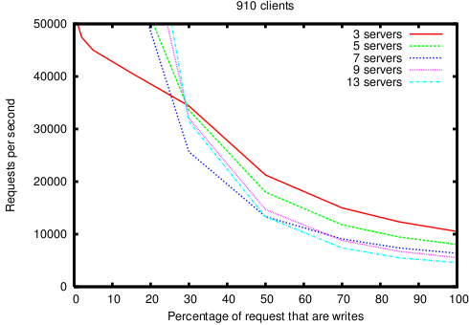
Performance

Slide 12
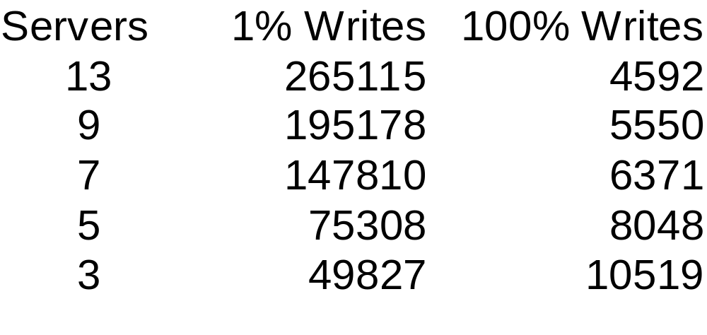
Performance at Extremes
Numbers are operations per second

Slide 13
Status
Project started October 2006
Prototyped in Fall 2006
Initial implementation of production service March 2007
Code moved to zookeeper.sf.net and Apache License November 2007
Java Quorum and Standalone servers
Java and C clients available

